Slide 1
Open a Chinese restaurant in Phoenix
Capstone Project - The Battle of Neighborhoods
Linpeng Sun

Slide 2
01
Introduction
02
Data
Table of Contents
03
Results
04
Discussion & Conclusion

Slide 3
Open a Chinese restaurant in Phoenix
Phoenix is the capital and most populous city in Arizona and it is also the fifth-most populous city in the United States.
Phoenix ranks as one of the fastest-growing cities in the United States. Because of that, it is also a city with cultural diversity.
My business problem is: If I want to open a Chinese restaurant in Phoenix, where is the best location of the restaurant?

Slide 4
Data acquisition and cleaning
Data of existing Chinese restaurants in Phoenix can be found by using Foursquare API.
After data cleaning, I collected data of 20 Chinese restaurants near the location I picked.
Each data contains 34 features.

Slide 5
Cleaned data (head)
uid | name | shortname | postalcode | lat | lng
51a4187a498e776dbdf0a798 | Panda Express | Chinese | 85004 | 33.445681 | -112.066992
4bdb3ffb3904a593d077499e | Wong's Chinese Dining | Chinese | 85034 | 33.436630 | -112.056730
413ba880f964a520311b1fe3 | China Chili | Chinese | 85012 | 33.485868 | -112.069035
4b58bbdaf964a520206828e3 | Mu Shu | Chinese | 85015 | 33.480710 | -112.091737
5101ca8de4b02714c07746df | New Garden Chinese Central & Hadley | Chinese | 85041 | 33.439237 | -112.073530

Slide 6
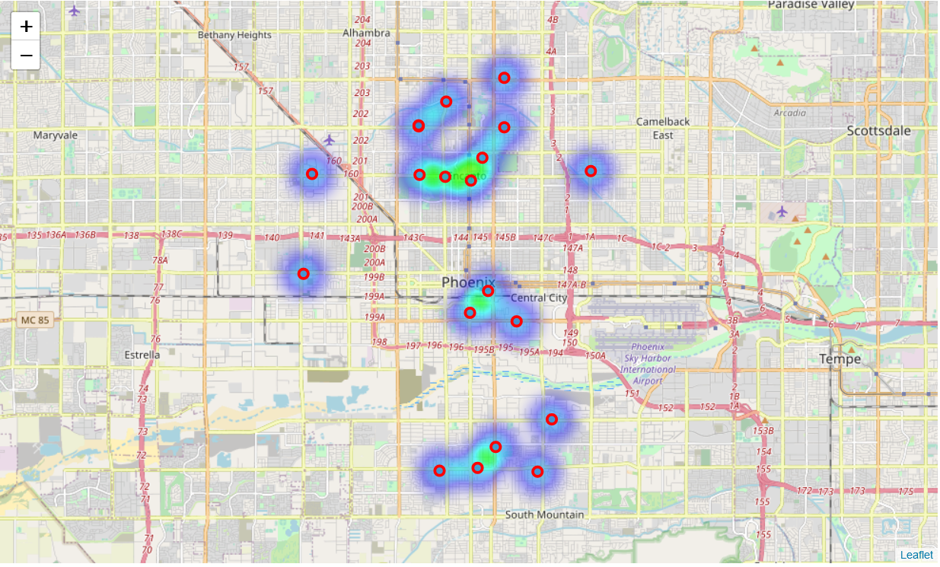
Location of the restaurants and customer flow distribution

Slide 7
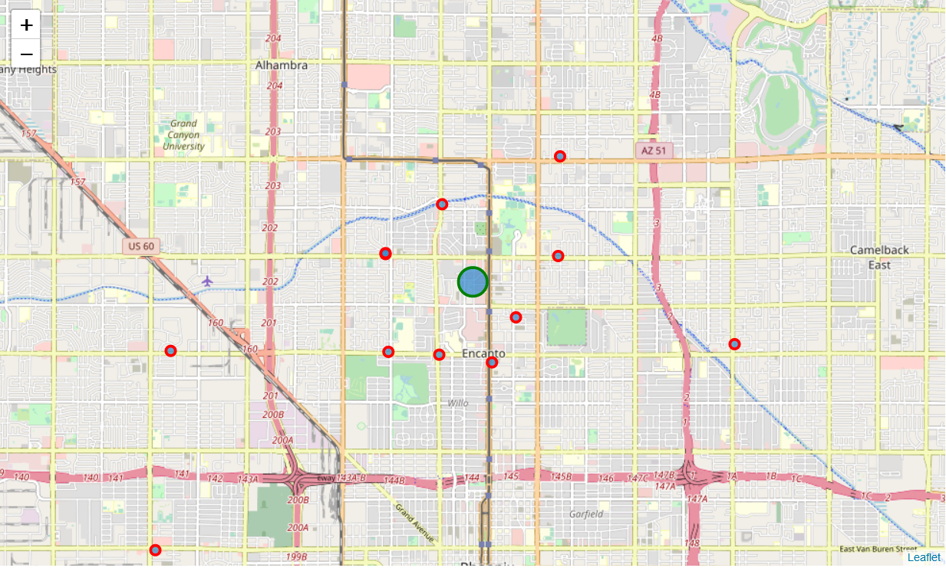
Final location of the new restaurant (blue bubble)

Slide 8
Conclusion and future directions
The final location is [33.49112718514639, -112.07669974657294]. Which surrounded by three hotels and one bank.
Therefore, the location could have a large number of potential users.
There are other methods can be used to determine the location instead of using the “heat map”. e.g. K-means clustering, etc.

Slide 9
THANK YOU

